Slide 1
Intro to Data Analysis
Udacity
https://classroom.udacity.com/courses/ud170

Slide 2

LESSON 1.
DATA ANALYSIS PROCESS

Slide 3

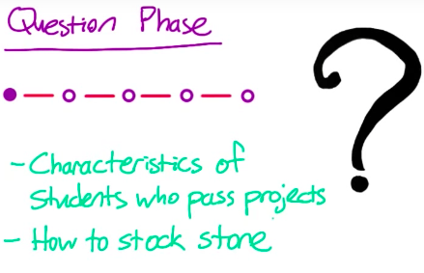
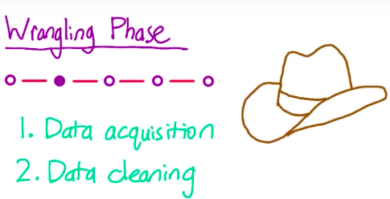
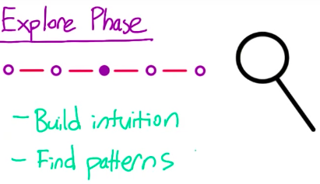
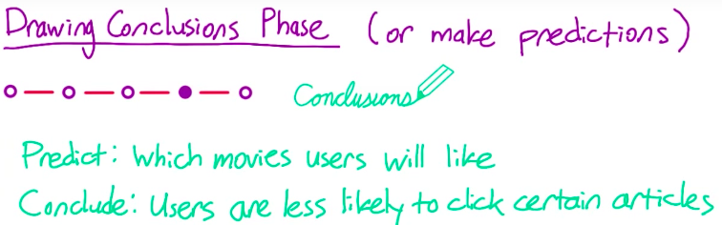
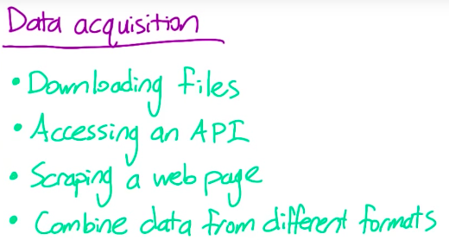
3. Data Analysis Process

Slide 4
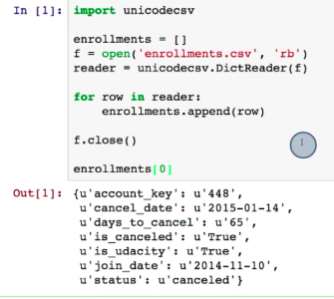
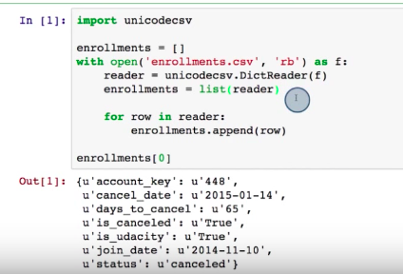
5. Intro to CSVs
Notes:
By calling list(reader) → we create a list of enrollment data without using a loop

Slide 5
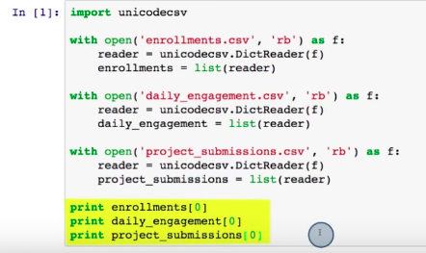
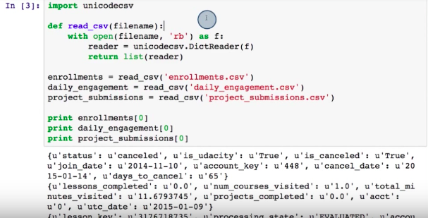
6. Quiz: CSVs in Python
Notes:
1st input works. But anytime you find yourself copy and paste code, it’s better to do it in 2 (to write a function so that if you find a bug later then you only need to change it in one place

Slide 6
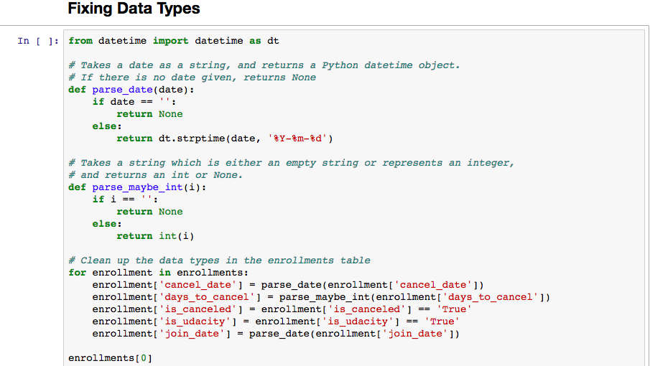
7. Fixing Data Types
Notes:
cancel_date converted into a date format by doing def parse_maybe etc.
If i – ‘’: → student date can be 0 if the student hasn’t returned it yet
Return = instead of creating a variable

Slide 7
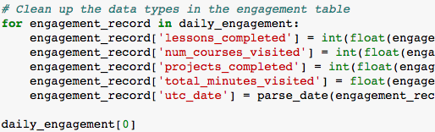
Notes:
is changed to integer because if you see the output of daily_engagement

Slide 8

8. Quiz:

Slide 9
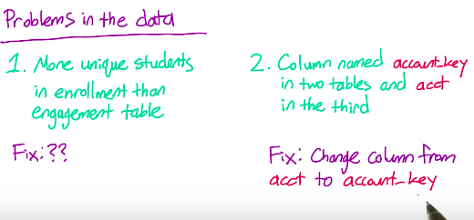
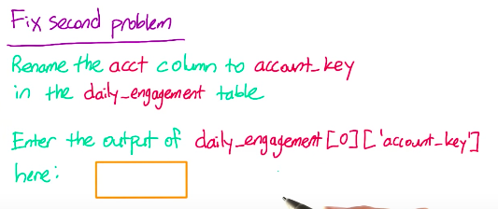
10.Quiz: Problems in Data

Slide 10
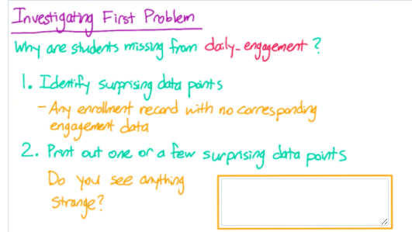
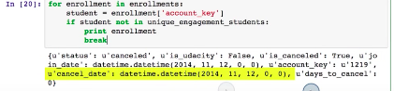
11. Quiz: Missing Engagement Record
Notes:
Problem: Notice that the join date and cancel date is the same equal to 0

Slide 11
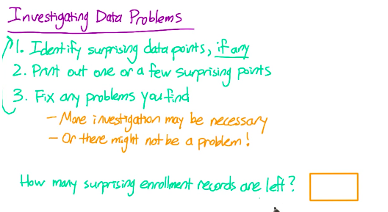
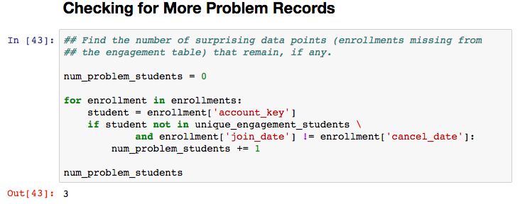
12. Quiz: Checking for More Problem
Notes:
Num_problem_students = 0 → to create a variable to store the number of problem exist
Then make a code to check whether account_key was present in daily_engagement
Also add another check to see if join date is the same as cancel_date

Slide 12
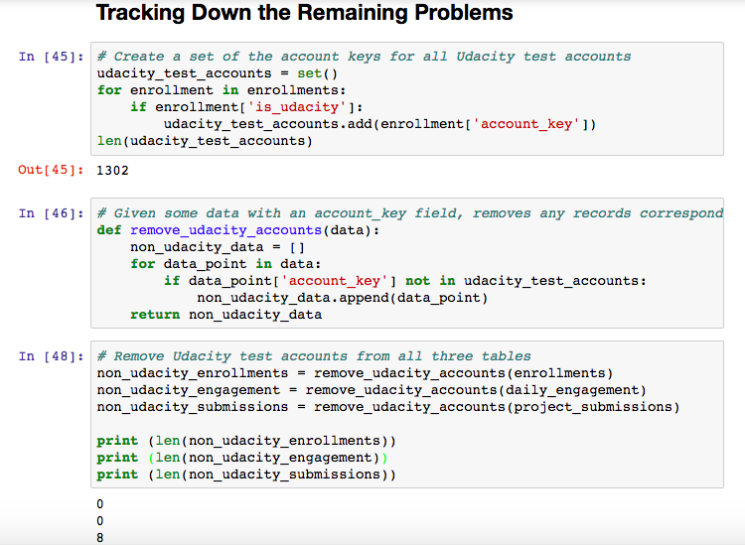
13. Tracking Down the Remaining Problems
Notes:
is_udacity: True --> meaning that students are taking test but don’t present in daily_engagement
Last part → called function and check how many left in each

Slide 13
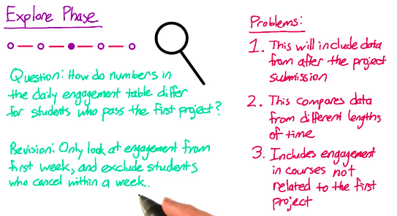
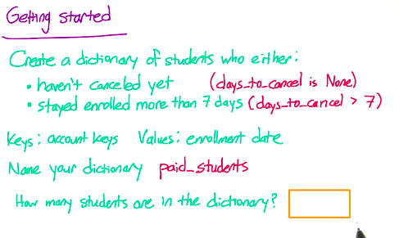
14. Quiz: Refining the Question

Slide 14
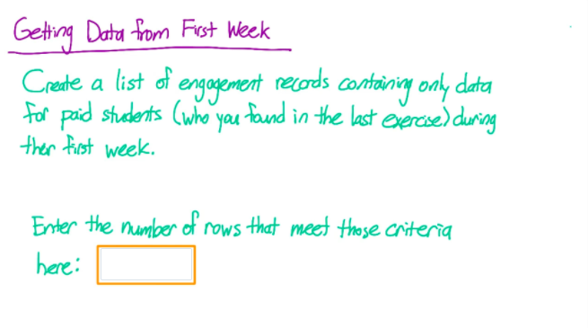
15. Quiz: Getting Data from First Week

Slide 15
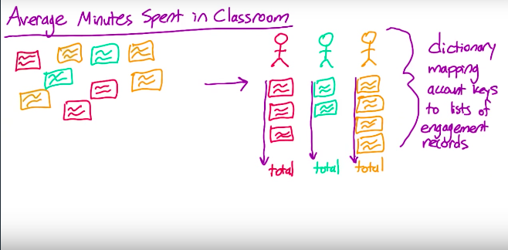
17. Exploring Student Engagement

Slide 16
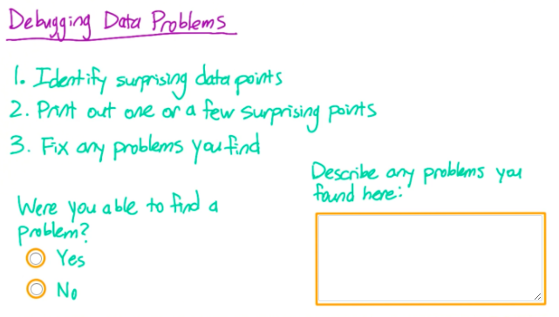
18. Quiz: Debugging Data Analysis

Slide 17
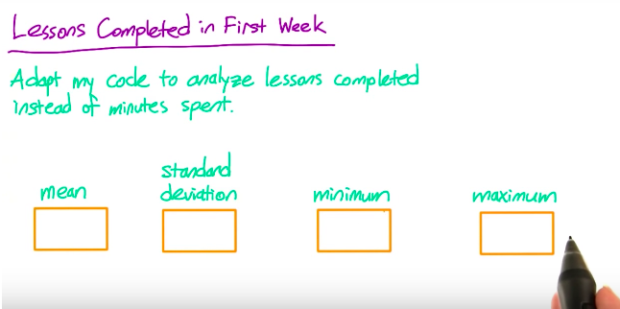
19. Quiz: Lessons Completed in First Week

Slide 18
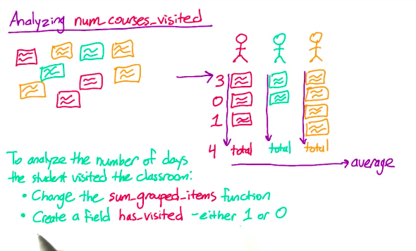
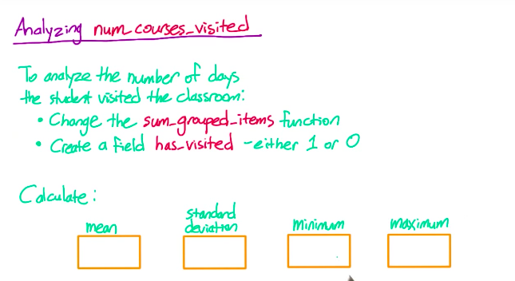
20. Quiz: Number of Visits

Slide 19
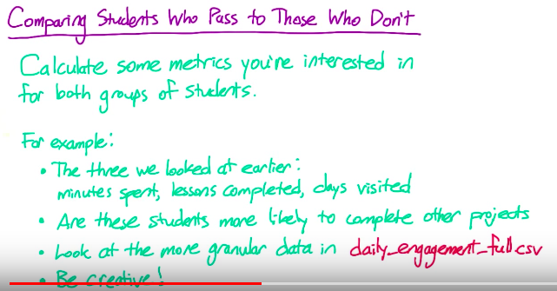
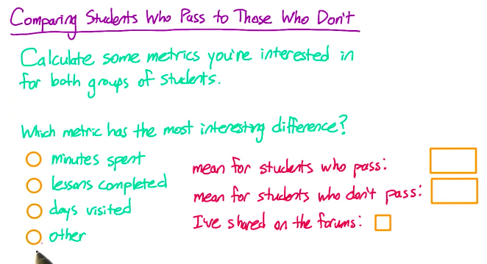
22: Quiz: Comparing the Two Student

Slide 20
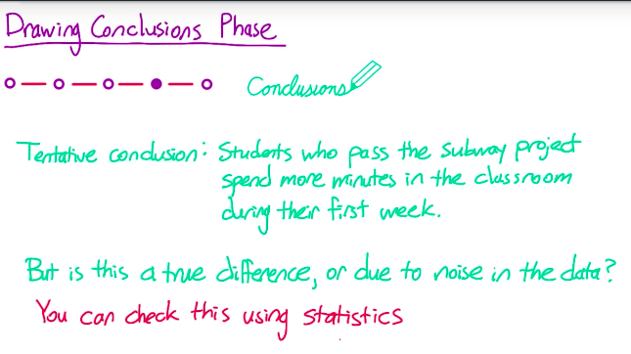
24. Are your Results just noise?

Slide 21
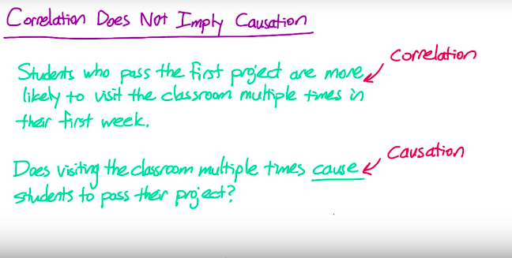
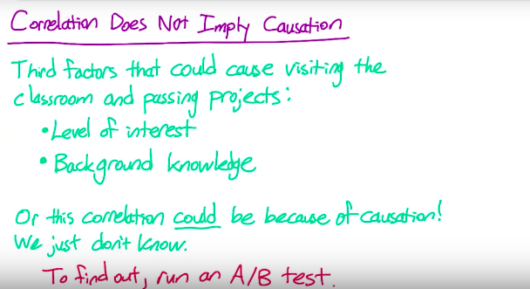
25.

Slide 22
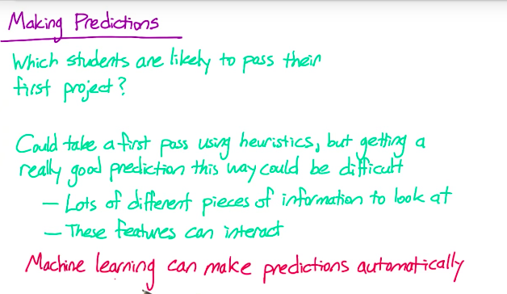
26.

Slide 23
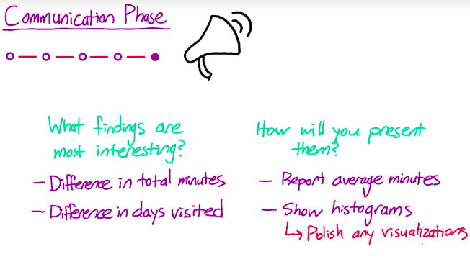
27.

Slide 24
LESSON 2.
NUMPY AND PANDAS FOR
D1 DATA

Slide 25
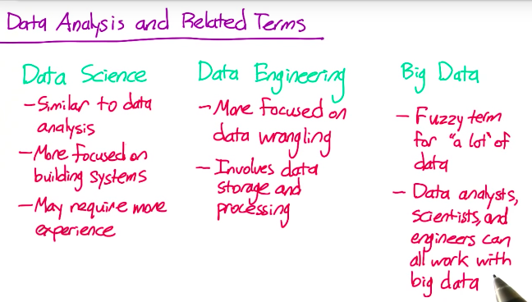

Slide 26
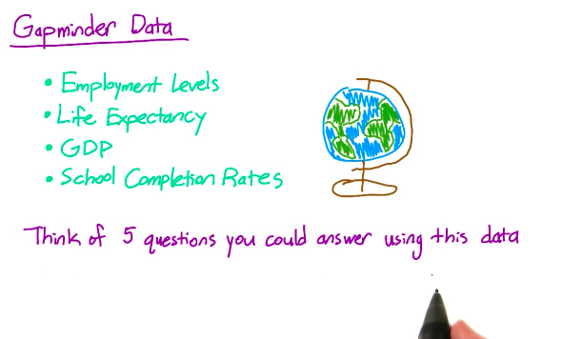
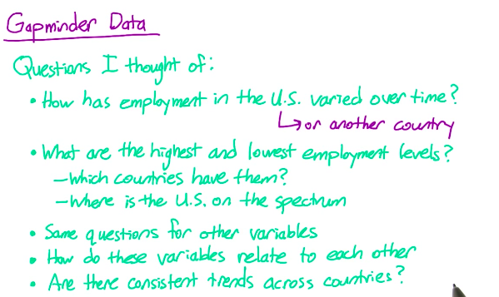

Slide 27
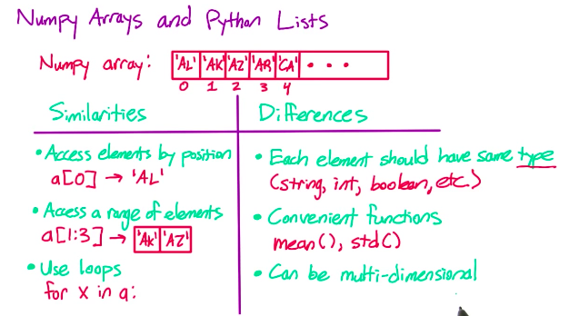
4. Quiz: Numpy Arrays

Slide 28
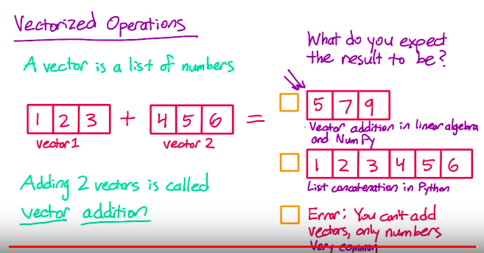
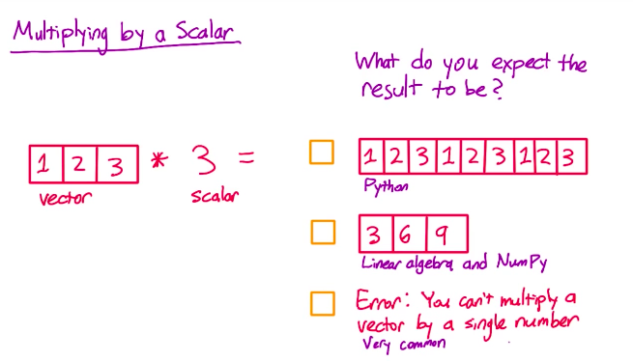
5 6. Quiz: Vectorized Operations & Multiplying by a scalar

Slide 29
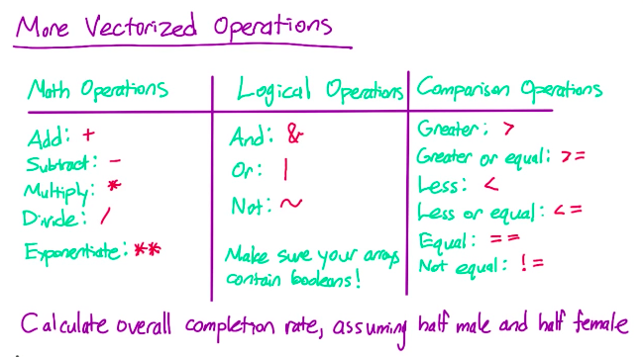

Slide 30
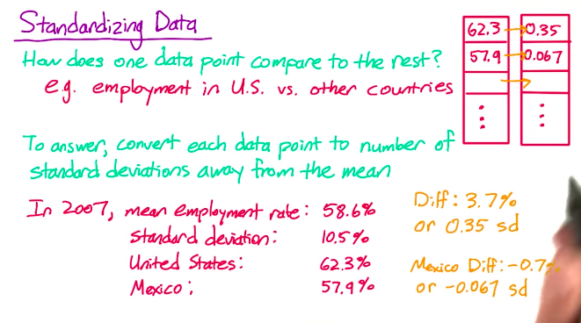

Slide 31
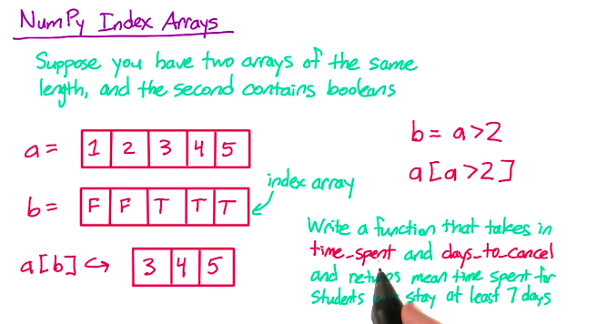
9. Quiz: NumPy Index

Slide 32
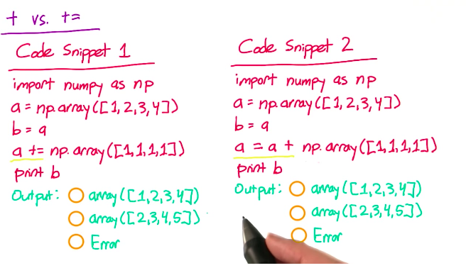
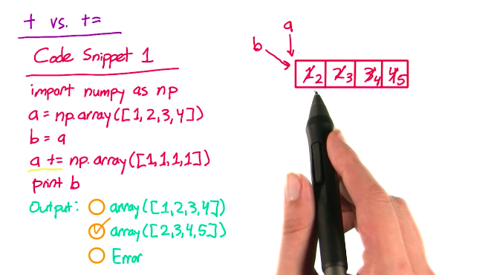
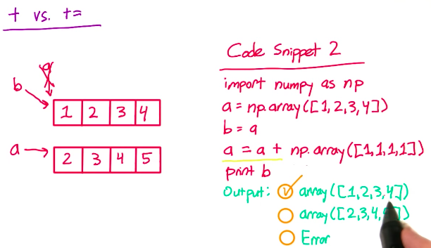
10. Quiz: + vs. +=

Slide 33
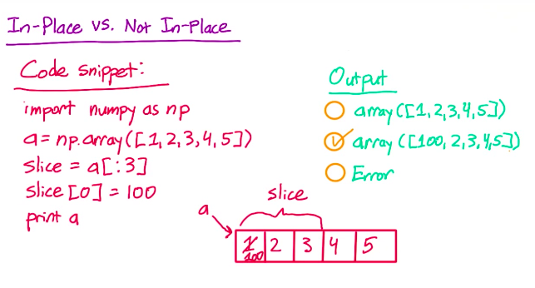

Slide 34
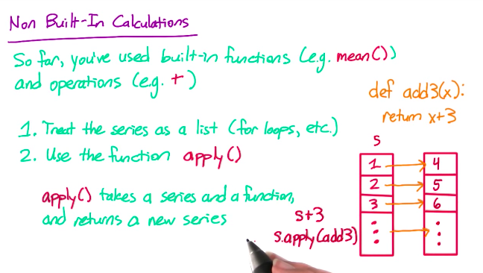
16. How to perform computation if it’s not built in Panda library? Pandas series apply()

Slide 35
LESSON 3.
NUMPY AND PANDAS FOR
2D DATA

Slide 36
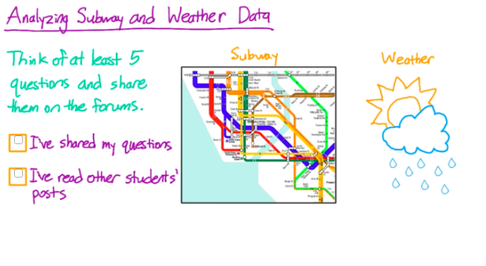
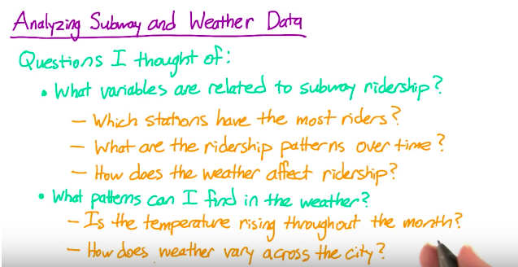
1. Subway Data

Slide 37
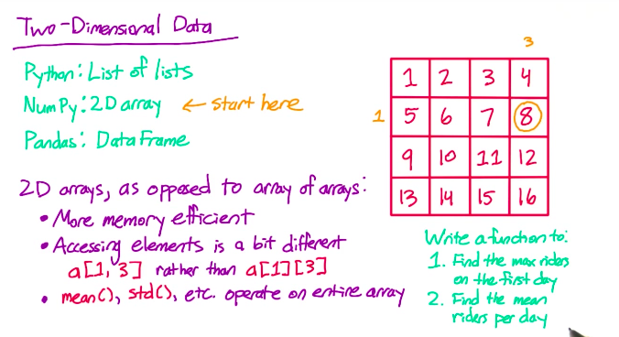
3. 2D NumPy Arrays

Slide 38

8. Quiz: Calculating Correlation
Notes:
Ddof = 0 → many times when we standardize variable, it doesn’t matter too much whether we take the corrected or uncorrected SD. But to calculate PEARSON’S R specifically, it’s important to take the uncorrected SD which we can do using ddof=0

Slide 39

9. Pandas Axis Names

Slide 40

10. Quiz: Shift() Function

Slide 41

11. Quiz: DataFrame apply()

